Slide 1

Rachel Makwela

Slide 2
About me
My name is Rachel Makwela, an Interior Decorator based in Johannesburg, married and blessed with two children. Tshegofatso is my eldest son who is 17 years of age and my baby girl Tsholofelo is 13 years of age. I developed the interest of design and decorating 26 years ago attended the IIE Design School of Southern Africa where I have graduated with a distinction as an Interior Decorator 2017. It is true when they say design goes hand in hand with fashion because I love clothes to bits. I enjoy playing with fabrics different textures and colours my favorite colours are dark blue, Red and white. Dark blue is often associated with depth and stability, and also it slows human metabolism and produces a calming effect. Red is associated with meaning of love, passion, anger and danger whereas white is associated with coolness, cleanliness, sterility and perfection. My hobbies are travelling, shopping and watching TV. My time at the Design School of Southern Africa gave me the opportunity to explore design and décor in a broader way although it was challenging at times especially when it comes to measuring rooms and drawing floor plans however we had critical direction and guidance from our lecturer. In a decor world one benefits from the convenience of a one stop destination for all your home furnishings requirements, with a vast range of quality furniture, flooring solutions, wall and windows coverings, lighting as well as home accessories, you can find inspiration interior design solutions in one place.

Slide 3
Portfolio

Slide 4
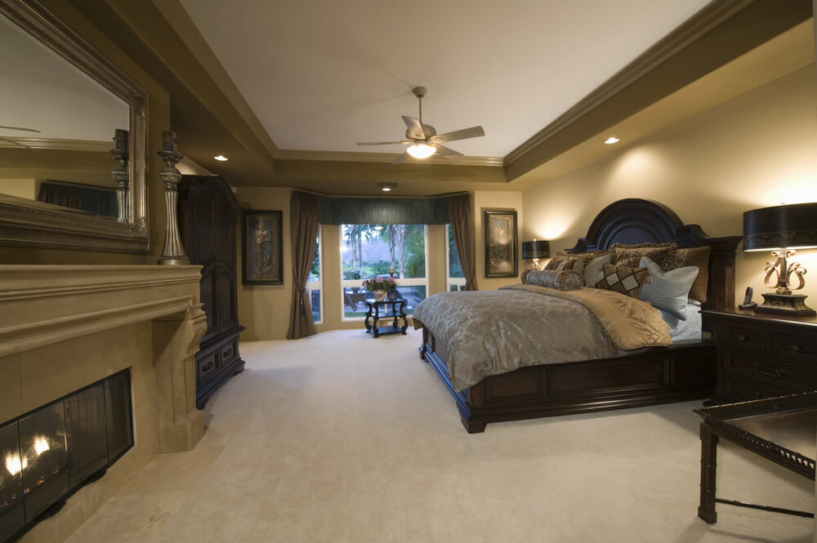
Master bedroom

Slide 5
Master bedroom
This room should be peaceful, functional and airy. Normally what’s included in a bedroom is a bed, dresser, chest of drawers, mirror and wardrobes; combined called a bedroom suite.
Even when the day is pure chaos, a bedroom is the one place where one should always be able to relax and unwind. Most people want their bedroom to be a soothing, restorative retreat. If that’s your wish, Visualiseit recommends that you consider calm and natural colours. The client may also look for a sophisticated palette that manages to be both masculine/feminine and glamorous at the same time.
Defining a bedroom space is important for the following reasons:
Value – The number and size of bedrooms can significantly increase the value of the house.
Recent trends are to have a walk in closet and en-suite bathroom.
There are endless possibilities when it comes to designing a bedroom. Visualiseit is well positioned to give professional advice on various design trends. Layer rugs on the side of the bed can provide added comfort, without the expense of changing the whole carpet. Layer scatter cushions of different patterns and textures can be added to a bed/bedroom to give a refreshing feel. Visualiseit recommends that décor and design is kept minimal in order for the headboard to do all the talking.

Slide 6
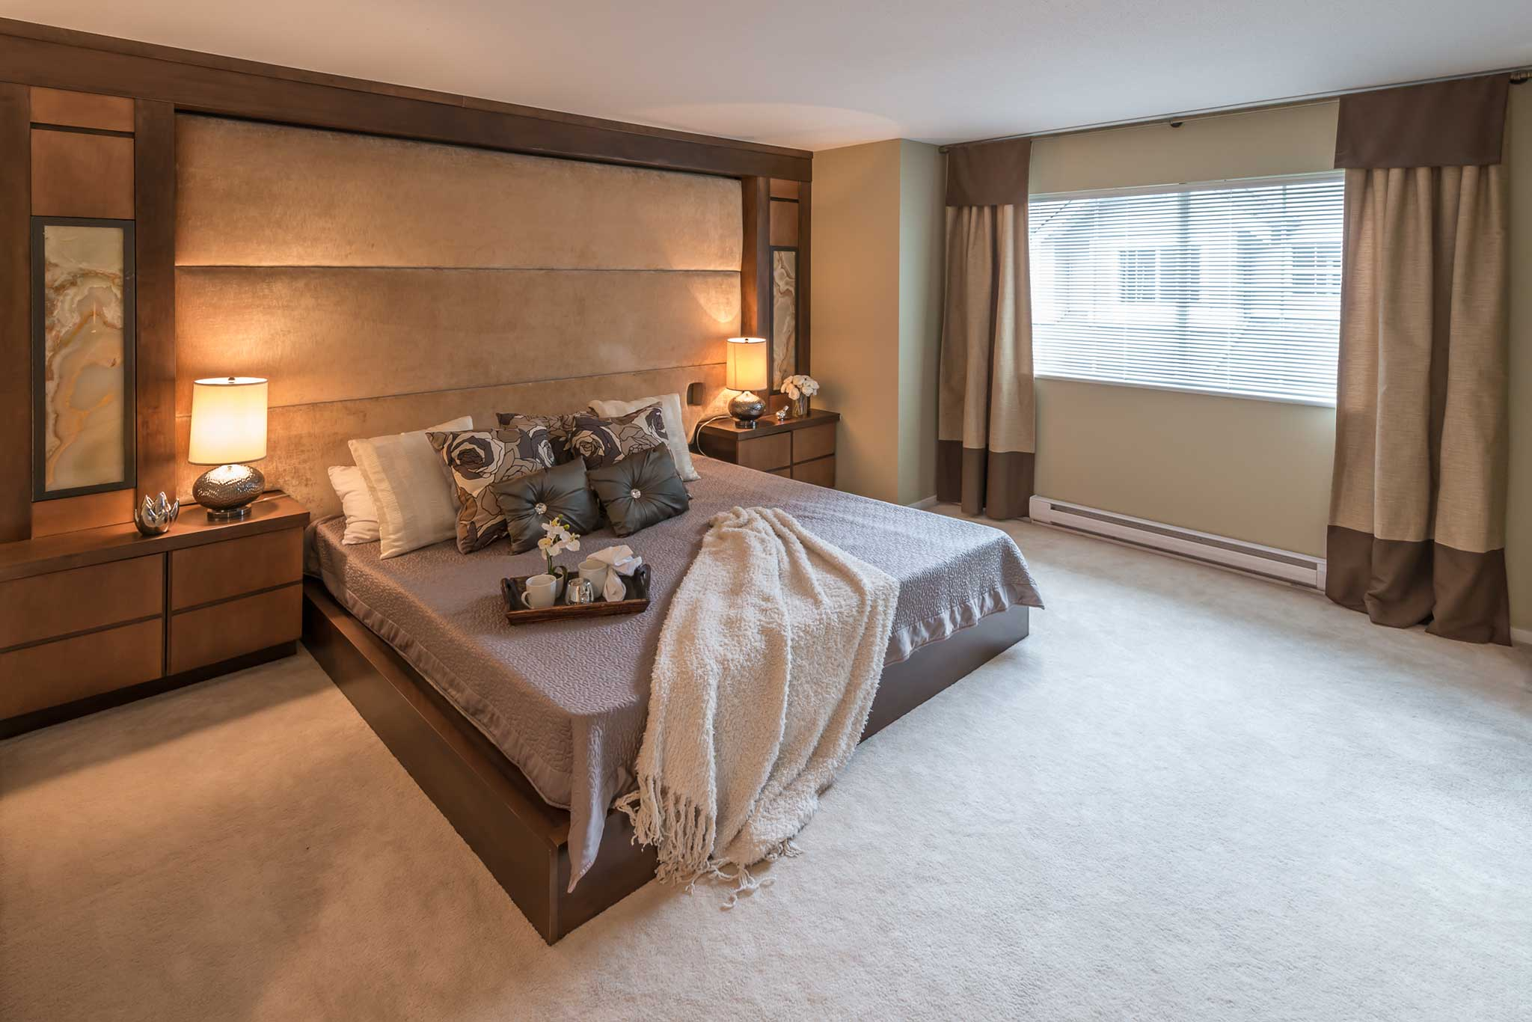
Guest bedroom

Slide 7
Guest bedroom
The Guest bedroom is a spare bedroom in a house that is used to accommodate visitors for an overnight stay. This bedroom is generally infrequently used. This room should make a visitor feel at home, comfortable and welcomed.
Paired with an en-suite bathroom, natural or earth colours and all the right additions to create a soothing atmosphere, cozy feel, classic and luxurious space it will leave a long and good impression on your guests.
Also while style is important provide your guest with necessary items like bed side lamp for reading, glass for water and reading materials such as newspaper or magazine. A bedside pedestal is also important for guests to put their belongings e.g. Mobile phone, spectacles, sunglasses, car keys etc.
If the guest bedroom is spacious enough, you may consider providing the following;
Water kettle, cup, sachets of coffee, sugar and milk. This may be ideal for visitors to have that warm hotel or homely feel. An alarm clock may also be added on the pedestal.

Slide 8
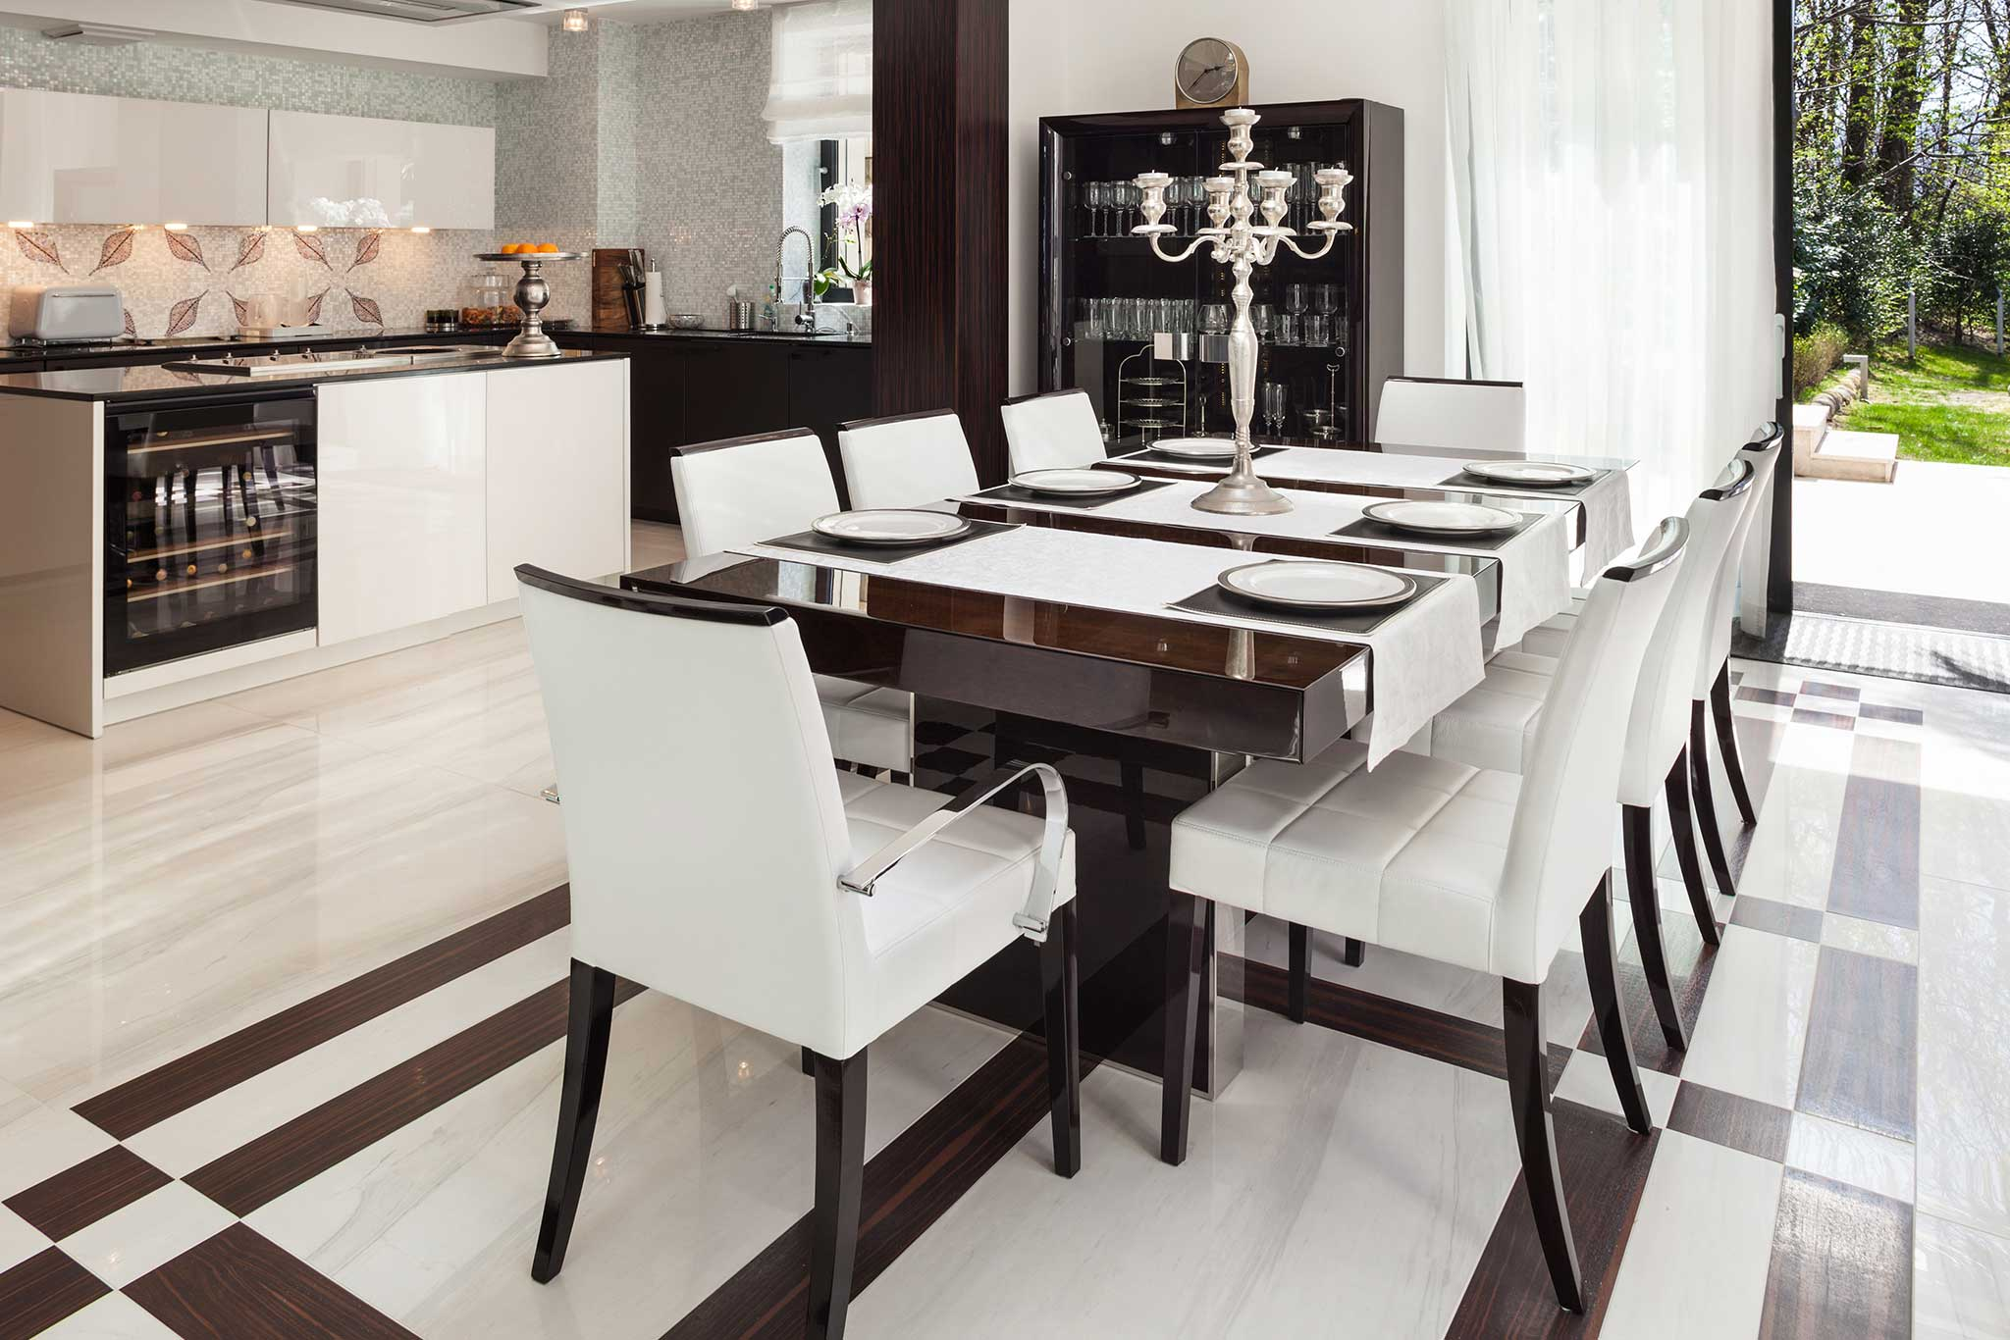
Dining room

Slide 9
Dining room
Dining Room is a room in a house or a hotel where meals are served or a place where the family assembles for breakfast, lunch or and dinner. Common types of dining room sets are contemporary, traditional and minimalist. As an example, a Contemporary dining room set encompasses a wide range of styles, but, for the most part, they consist of a sturdy rectangular table, often made of wood, paired with fabric dining chairs.
There are different styles of dining tables;
Round Pedestal
Traditional Oval
Farmhouse
The most common table shape is generally rectangular with two armed end chairs and an even number of un-armed side chairs along the long sides. They are also advantageous in terms of space as some of the tables can be extended to accommodate a larger number of guests. The table can also be kept un-extended in order to maintain an even spacious dining room.
An ideal dining table top should have the space to hold the food plus plates, glasses and cutlery for all members of the household, comfortably, and where necessary a couple of guests as well. Modern design dictates that a dining room table is placed adjacent to the kitchen for convenience in serving. It is interesting to note that in the Middle Ages, family dining was often on an entirely different floor level or section.
Some of the accessories a dining room needs:
Vases
Candles and candlesticks – nothing is more romantic than dining under a soft glow
Mirrors – mirrors add instant depth and light in a room
Table linens – food always feels fancier when it’s served atop a beautiful table cloth and plates always appear prettier when they are on a placement. A cloth napkin on your lap completes a romantic setting.
Chandelier(s)
All these are also dependent on the style the client wants as well as recommendations from Visualiseit.

Slide 10
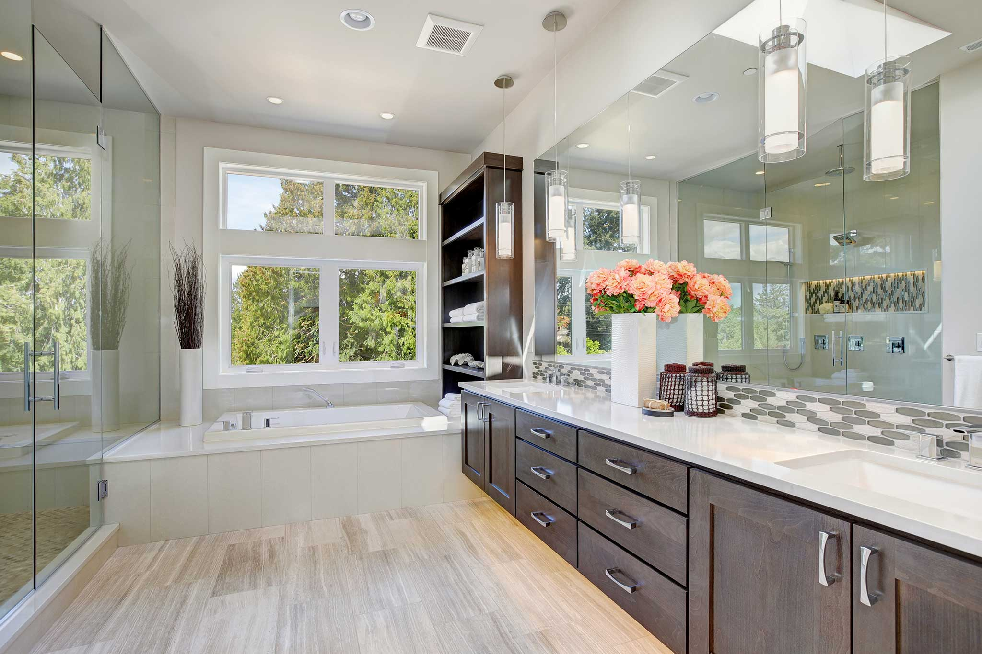
Bathroom

Slide 11
Bathroom
Contains a basin or two and either a bath tub or a shower or both. In most cases a toilet is included in this room for ease of plumbing as cost consideration.
Items found in bathroom: Bathroom mats, toilet brush cleaner, towel rails, toilet paper, soap and hand towel holders.
Plumbing: The design of a bathroom must account for the use of both hot and cold water in adequate quantities.
Electricity: Electrical appliances such as lights, heaters and heated towel rails generally need to be installed as fixtures with permanent connections rather than plugs and sockets in line with safety legislation.
Lighting: Bathroom lighting should be uniform, bright and must minimize glare in order to ensure equitable lighting across the entire bathroom space. Choose lighting of modern style (e.g. LED’s) design and remember that at times, the quality of the light may be more important than the light itself.
Modern bathrooms create a simplistic and clean ambience. The philosophy of Visualiseit is premised on the approach that in order to design a modern bathroom, it must be ensured that geometric shapes and patterns, clean lines, minimal colors are utilized. Furthermore the bathtub, shower and related accessories should mirror the design concept in order to create a good flow and pattern.
These modern details can transform a dull bathroom into a fantastic relaxation and refreshing space.
We are of the view that when choosing tiles for a modern bathroom, a client should stick to one pattern, size and colour for both floor and wall in order for the bathroom to look modern and stylish.
Look for patterns and colors that fit into those categories when looking for the type of faucet, mirror and fixtures you are choosing to place in your modern bathroom.

Slide 12
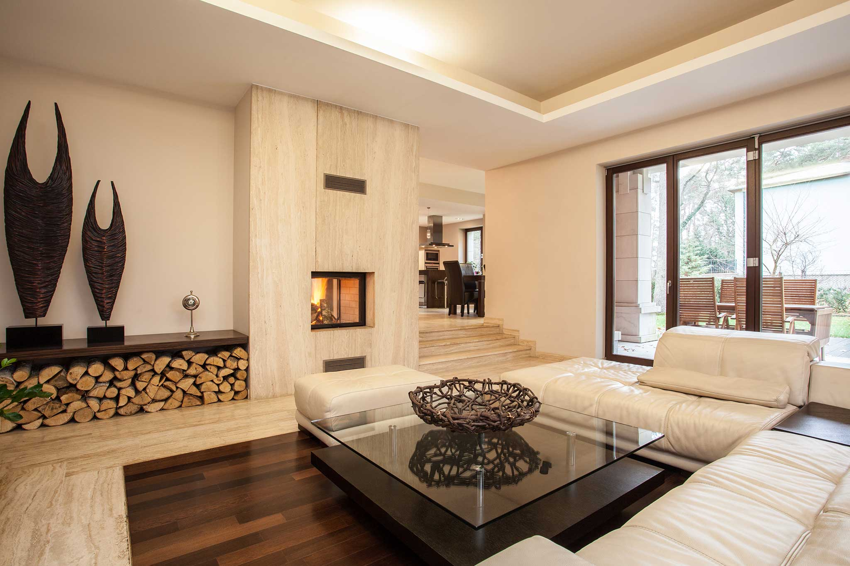
Living room

Slide 13
Living room
Living room is a room for general everyday use in a house. Also called a lounge or sitting room, it is a room in a residential house used for relaxing, socializing or even watching TV.
Usually, the living room is the most spacious room of the house. In most cases it is at the heart of the house. In an open plan scenario, it is usually connected to the dining room. Generally, a family room is adjacent to the kitchen and in some cases it becomes an extension of the kitchen itself.
The living room is the space where we entertain our guests and welcome friends and relatives. It’s a comfortable but also somewhat formal area
Sometimes the simplest room makeovers are the best because they turn to make the space feel bigger and new e.g. by introducing scatter cushions with different patterns and textures. These small projects can freshen up a home without the owner spending a small fortune.
In a living room one needs comfortable type of couches like English sofa’s which are known as Gomma gommas. They are known to have low arms in relation to a high back and are generally covered with upholstery. Modern designed English couches recline and are well cushioned for absolute comfort.
Depending on the design principle, leather couches fitting with the colour scheme or created to contrast with the colour or pattern of the room can be a proper fit for a living room. Visualiseit is well positioned to guide the client in this arena taking into consideration, client’s budget, style consideration and personality as these ingredients should all be considered in a home or room makeover.

Slide 14
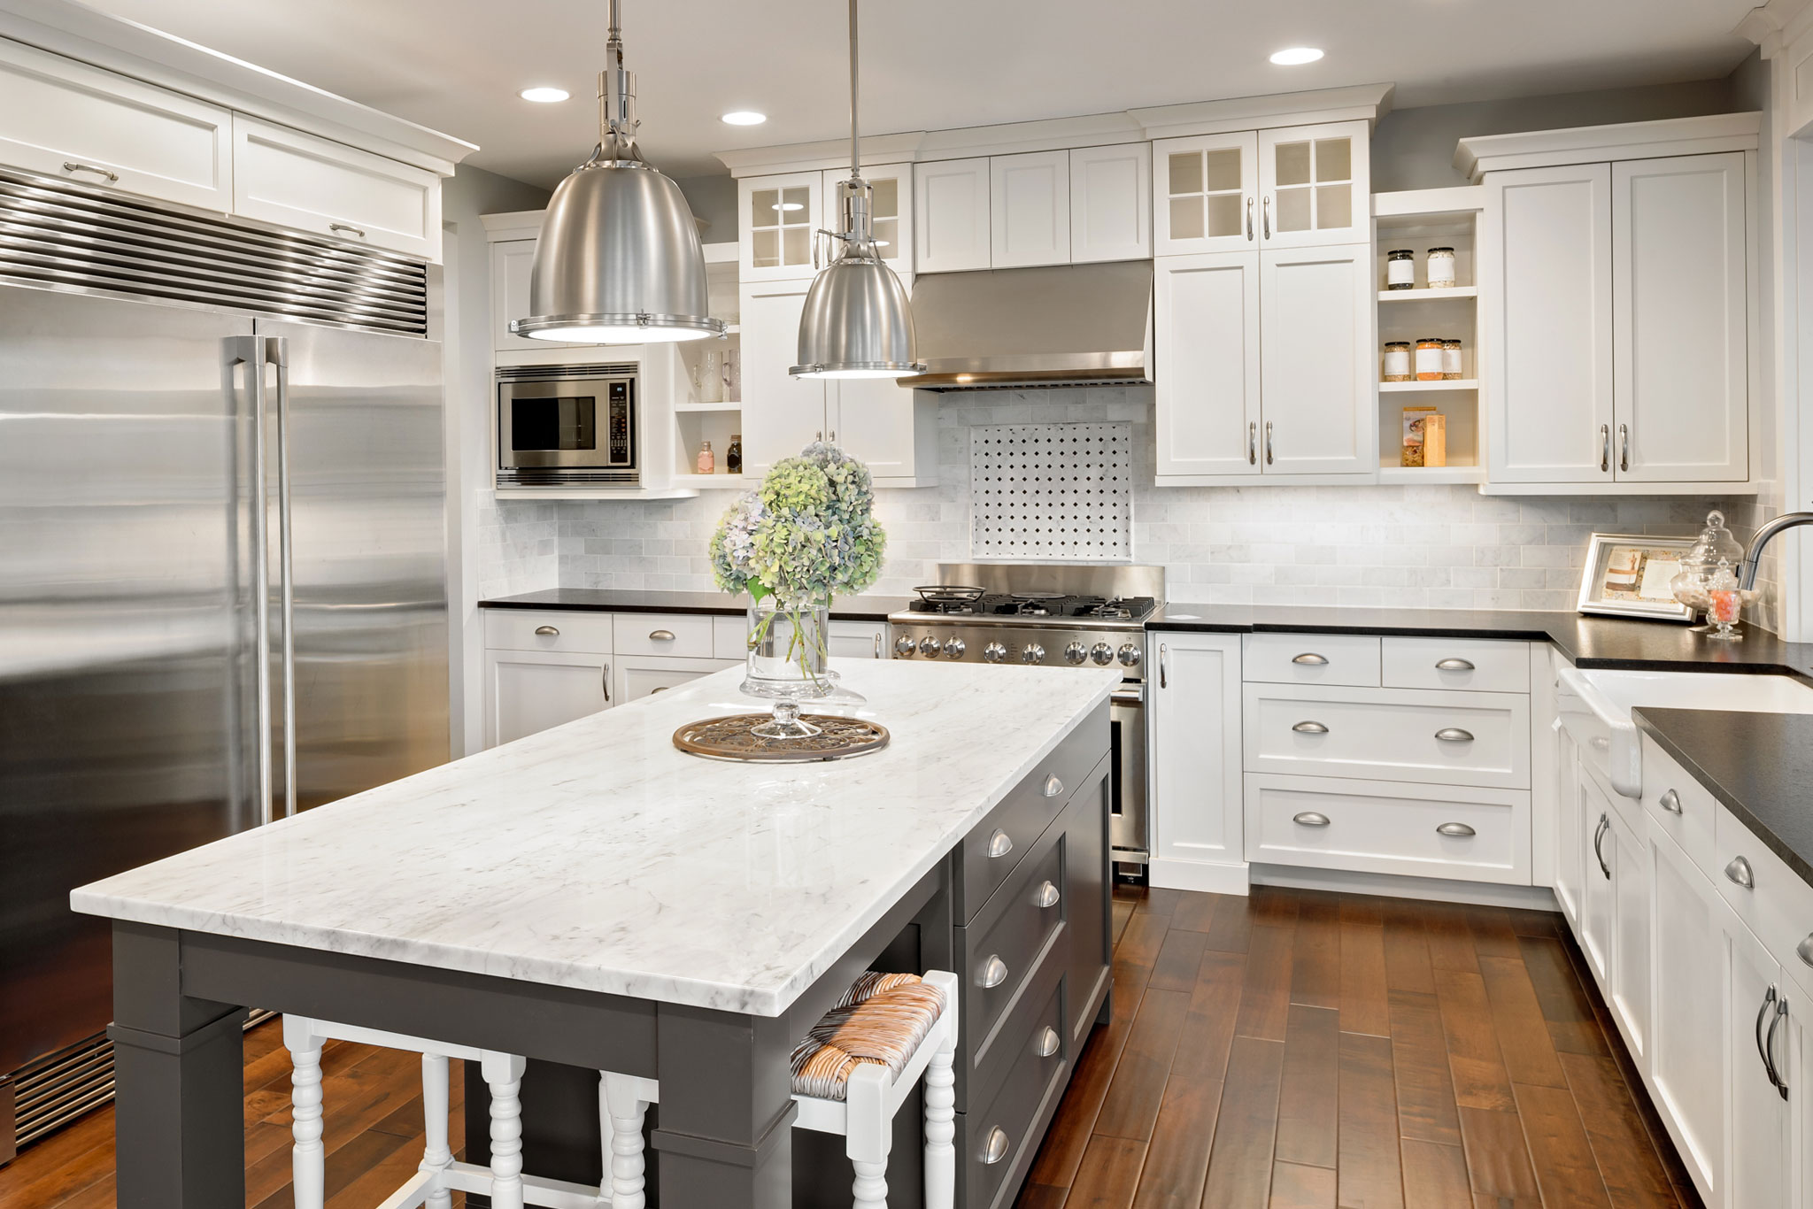
Kitchen

Slide 15
Kitchen
A kitchen is the heart of the home, a room used for cooking and food preparation in a dwelling or in a commercial establishment. A modern residential kitchen is typically equipped with a stove, sink with hot and cold running water, a refrigerator, microwave oven. In some instances you would find a scullery with a dishwasher, washing machine and a tumble dryer.
In these modern kitchens you would find that the space is versatile, the family can enjoy meal seated around the spacious kitchen island with those high space bar stools. The kitchen units could typically be made of high gloss cabinets which are easy to clean. They are also easy to blend with other materials such as wood, stone and stainless steel and can also blend with modern granite countertops.
In the olden days kitchen windows used to be covered with café curtains and hanged on wooden pelmets. In contrast, in modern kitchens shutters or blinds are installed and are one of the most versatile types of window coverings. They are easy to clean and are a permanent fixture. Since this is a permanent fixture, Visualiseit will be on hand to make recommendations in order to ensure that these match the design concept longevity. Blinds and Shutters are supplied in various kinds of wood such as Mahogany, Oak, Beech and Pine. Recent trends have also brought aluminium shutters in the picture. This is an exciting design concept as this has made the options of colours almost infinite. Furthermore this ensures that the same aluminium shutters provide extra security in the form of prevention of household intrusion whilst maintaining a stylish look and feel.
Types of Kitchens
Kitchen Island
L – Shaped
U – Shaped
Single wall
Visualiseit is available to discuss Client requirements. An option would be to undertake a wholesome upgrade however depending on client’s needs a single room or defined rooms can be spruced up.

Slide 16
Contacts
5 Muller Street South, House no 59, Savannahs, Buccleuch, Johannesburg
+27 83 941 1592 | +27 63 104 2742 rachel.makwela@videsigns.co.za
Rache.makwela@gmail.com

